Slide 1
KPO CHEMICAL TECHNICAL WEBINAR
KARACHAGANAK PETROLEUM OPERATING B.V
24/06/2024

Slide 2
AGENDA
  WELCOME SPEECH
  WEBINAR RULES
  OVERVIEW OF CHEMICAL PRODUCTS IN KPO WELL OPERATIONS
  OVERVIEW OF CHEMICAL PRODUCTS IN KPO OPERATIONS
  KPO SUPPLIERS DATABASE
  KPO PROCUREMENT PROCESS
  SUPPORT MECHANISMS FOR LOCAL SUPPLIER
  Q&A SESSION
2

Slide 3
Webinar Rules

Slide 4
WEBINAR RULES
  We will have a Facilitator to manage this event
  Everyone except Presenters will be muted
  If you want to ask a question, please type it in the comments box
  Try to hold questions to the end of the presentation
  Be open, honest and respectful
  Don’t
    use this webinar to market your company
    ask a question regarding any specific Tender/Contract
    expect total clarity and precise response to your every question

Slide 5
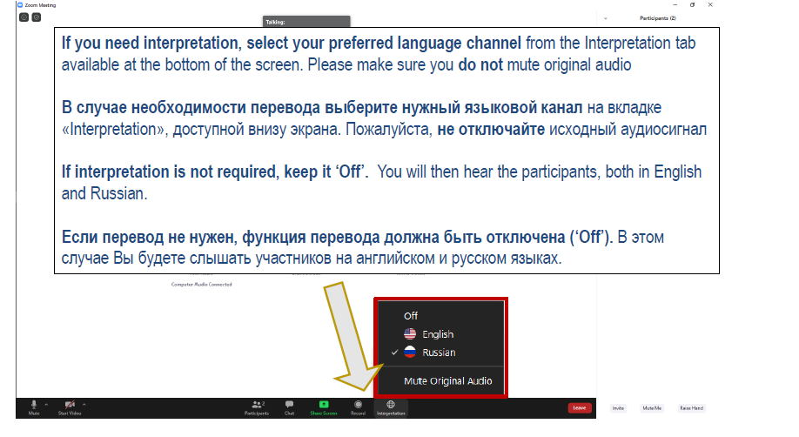
CHANNEL

Slide 6
База данных поставщиков КПО
Svetlana Sansyzbayeva
Well Operations Fluids Superintendent
27/02/2024 КОНФИДЕНЦИАЛЬНО КАРАЧАГАНАК ПЕТРОЛИУМ ОПЕРЕЙТИНГ Б.В.

Slide 7
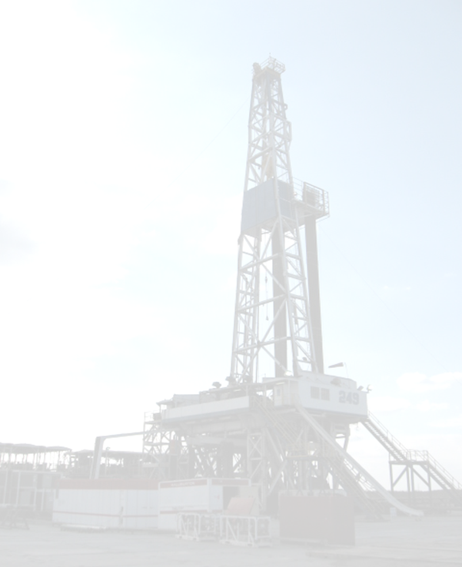
DRILLING OPERAITONS OVERVIEW / ОБЩИЙ ОБЗОР ОПЕРАЦИЙ ПО БУРЕНИЮ
Отдел скважинных операций выполняет бурение на месторождении Карачаганак с использованием двух буровых установок, посредством подрядной компании совместного предприятия ТОО «КМГ-ПАРКЕР» .
Новые эксплуатационные скважины бурятся с помощью двух буровых установок, каждая из которых бурит 3-4 скважины в год, всего до восьми скважин в год.
Работы по капитальному ремонту выполняются время от времени с помощью , буровой установки, которая ремонтирует или заменяет устья скважин и/или углубляет существующие скважины.
The Well Operations department performs drilling at the Karachaganak field using two drilling rigs provided by the JV of KMG-PARKER Business Partners.
New development wells are being drilled by a two-rig fleet, with each rig drilling 3-4 wells per year, for a total of up to eight wells drilled each year.
Workover activities are carried out from time to time by a workover rig, which repairs or replaces wellheads and/or deepens existing wells.
Drilling Rig 249:Completed drilling of new well 9883 and is currently running completion operations.
Drilling Rig 258:Completed drilling of well 9884 and is currently running completion operations.
Буровая установка 249: Завершено бурение новой скважины 9883, в настоящее время выполняются операции по завершению.
Буровая установка 258: Завершено бурение скважины 9884, в настоящее время выполняются операции по завершению.

Slide 8


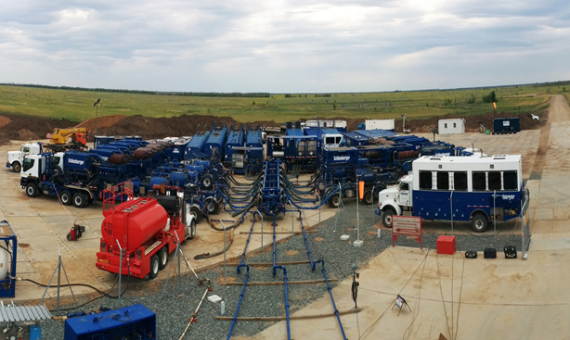
WELL SERVICES OVERVIEW / ОБЩИЙ ОБЗОР ПРИ подземном ремонте скважин
The following contractors are involved in well services activities / Следующие подрядчики участвуют в деятельности по обслуживанию скважин:
QHSE-AKBARYS LLP – provides services on H2S neutralization during well services activities / TОО
«QHSE-AKBARYS» – предоставляет услуги по нейтрализации H2S во время выполнения работ на скважинах.
SLS Oil JV LLP provides coil-tubing service and chemicals supply for acid treatment of wells
TОО «SLS Oil JV» предоставляет услуги по использованию колтюбинга и поставке химических реагентов для кислотной обработки скважин.
Aksai Operating LLP provides stimulation service and chemicals supply for acid treatment of wells (acid treatment, acid Frac)
TОО «Аксай Оперейтинг» предоставляет услуги по стимуляции и поставке химических реагентов для кислотной обработки скважин (кислотная обработка, кислотный ГРП).

Slide 9
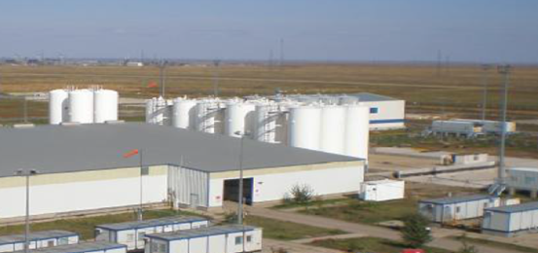
WELL OPERATIONS / СКВАЖИННЫЕ ОПЕРАЦИИ
Drilling Muds used for drilling, completion
and work over operations are prepared at
Liquid Mud Plant.
During the drilling of the 26” hole, water-based mud (WBM) is used.
During the drilling of the 16” hole until the pay zone, oil-based mud (OBM) is used. The OBM base is SARALINE.
This mud is stored for re-use at the liquid mud plant.
During the completion of wells, Sodium Chloride Brine is used.
Fluids for stimulation: HCL mixtures, Viscosifiers /emulsified acids, organic solvents. Corrosion inhibitors and H2S scavengers
Буровые растворы, используемые для бурения, завершения и ремонтных работ, готовятся на заводе по приготовлению буровых растворов.
Во время бурения скважины диаметром 26” используется буровой раствор на водной основе.
При бурении скважины интервала диаметром от 16” до продуктивного пласта используется буровой раствор на углеводородной основе.
Основа бурового раствора на углеводородной основе является САРАЛАЙН.
Этот раствор хранится для повторного использования на заводе по производству жидкого бурового раствора.
При закачиванию скважины используется рассол хлорида натрия.
Растворы для проведения работ по интенсификации притока скважин используются cмеси соляной кислоты, высоковязкие / эмульгированные кислоты, органический растворитель, Ингибиторы коррозии и поглотители сероводорода.

Slide 10
Local chemicals usage / Местные ИСПОЛЬЗУЕМЫЕ ХИМИКАТЫ
The current fluids business partner is NDFK, with 98% local involvement.
See the table below for the chemicals used by NDFK, which are produced in Kazakhstan.
Текущий бизнес-партнер по жидкостям — НДФК, с 98% местным участием.
См. таблицу ниже для химикатов, используемых НДФК, которые производятся в Казахстане.
Local Chemical used in 2023 -2024 / Местные химические вещества, использованные в 2023-2024 гг.
Name of product / Название продукта | Description/Описание | Usage / Использование, MT | Supplier / Поставщик
AVACARB /CaCO3, BB | Weighted material, LCM / Утяжеляющий материал, материал для борьбы с потерей циркуляции | 403 | ТОО "Каратау ПРО", ТОО "Алина Групп" / LLP "Karatau PRO", LLP "Alina Group"
Barite / Барит, BB | Weighted material / Утяжеляющий материал | 7,402 | ТОО "Каражал Оперейтинг" / LLP "Karazhal Operating"
Sodium Chloride / Хлорид натрия, m3 | Brine 1.19 sg / Рассол | 9309.4 | ТОО "АГС-Соль Добыча" / LLP 'AGS-SOL DOBYCHA

Slide 11
Local Chemical used / Местные ИСПОЛЬЗУЕМЫЕ ХИМИКАТЫ
The current cementing business partner is Baker Hughes, with 100% local involvement. We are also considering using locally sourced class G cement in our future cementing operations. See the table below for the chemicals used by Baker Hughes, which are produced in Kazakhstan.
Текущим бизнес-партнером по цементированию является Baker Hughes с 100% местным участием. Также, мы рассматриваем возможность использования местного цемента класса G в наших будущих операциях по цементированию. См. таблицу ниже для получения информации о химических веществах, используемых Baker Hughes, которые производятся в Казахстане.
Local Chemicals used in 2023 -2024 / Местные химические вещества, использованные в 2023-2024 гг.
Name of product / Название продукта | Description / Описание | Usage / Использованные, MT | Supplier / Поставщик
A-2 | Gelation Control / Контроль геляции | 20.1 | TOPAN LLP Kazakhstan ТОПАН ТОО Казахстан
A-7 | Accelerator / Ускоритель | 10.1
Sugar | Retarder / Замедлитель | 8.66
GW-22 | Gelling Agent / Загуститель | 1.52
R-2 | Retarder / Замедлитель | 1.76
Additionally, we are committed to ensuring that all materials meet the highest industry standards to guarantee the quality and safety of our operations. Collaboration with local suppliers not only enhances our operational efficiency but also supports the local economy and aligns with our sustainability goals.
Кроме того, мы стремимся к тому, чтобы все материалы соответствовали высочайшим отраслевым стандартам, что гарантирует качество и безопасность наших операций. Сотрудничество с местными поставщиками не только повышает нашу операционную эффективность, но и поддерживает местную экономику и соответствует нашим целям устойчивого развития.

Slide 12
Local Chemical used / Местные ИСПОЛЬЗУЕМЫЕ ХИМИКАТЫ
The current Well Service business partners is SLS Oil JV LLP and Aksai Operating LLP;
See the table below for the chemicals used by SLS Oil JV LLP and AO LLP, which are produced in Kazakhstan.
Текущий бизнес-партнеры по скважинным операциям SLS Oil JV LLP и Аксай Оперейтинг. См. таблицу ниже для химикатов, используемых SLS Oil JV LLP и Аксай Оперейтинг, производимые в Казахстане.
Products / Продукты | Consumption in 2023 / Потребление | Consumption in 2024 / Потребление
B628, H2S Corrosion Inhibitor / Ингибитор коррозии H2S | 18.5 m3 | 64.4 m3
U066, Mutual Solvent / растворитель | 21 m3 | 50 m3
B694, Corrosion Inhibitor / Ингибитор коррозии | 1.3 m3 | 4.5 m3
Y001, Intensifier / Интенсификатор | 1.2 MT | 1.76 MT
J716, Organic Solvent / Органический растворитель |  | 23 m3
H33, Hydrochloric Acid 33% / Соляная кислота 33% | 105.4 m3 | 390.9 m3
Nitrogen / Азот | 200 m3 | 950 m3
33% HCL / Соляная кислота 33% | 1381 MT | 670 MT
KPO does not purchase nor deal with producers of the chemicals for Well Operations but exclusively through the service provider who has its own suppliers / vendors.
КПО не покупает и не работает с производителями химических веществ для операций на скважинах напрямую, а исключительно через поставщика услуг, у которого есть свои собственные поставщики.

Slide 13
Imported Chemicals for Localization / Импортируемые химические вещества для локализации
KPO is interested in localization of the following chemicals / KPO заинтересована в локализации следующих химических веществ:
Drilling Fluids / Буровые Растворы |  |  | Cement slurry / Цементные растворы
# | General Name / Общее название | Average annual demand, MT / Среднегодовой спрос, MT | # | General Name / Общее название | Average annual demand, MT / Среднегодовой спрос, MT
1 | Base Oil / Базовое масло | 3500 | 1 | Dispersants / Диспергатор | 6.8
2 | Calcium Chloride (CaCL2) / Хлорид кальция | 350 | 2 | Mutual Solvent / Растворитель | 1.15
3 | Fluids loss control agents / Агенты контроля потерь жидкости | 25 | 3 | Foam Preventer / Пеногаситель | 1
4 | Lime / Известь | 300 | 4 | Expansion Control / Расширитель | 10
5 | LCM (various) /материал для борьбы с потерей циркуляции (различные) | 50 | 5 | Anti-settling Agent / Контроль осадки | 0.5
6 | Shale Inhibitor / Ингибитор сланцев | 50 | 6 | Spacer Surfactant / Буфер-ПАВ | 1.15
7 | Sodium Chloride Salt (NaCl) / Хлорид натрия | 50 | 7 | Bonding Agent / Газоблокатор | 2.5
8 | Viscosifiers / загустители | 25 | 8 | Fluids Loss Control / Агент по водоотдаче | 3.2
9 | Wetting agents / Смачиватели | 25 | 9 | FL & Rheology Control / контроль реологии | 10
Note: the average annual volumes may vary depending on the scope of work and number of rigs.
Should forum participants be interested in development/localization of chemicals production in the territory of the Republic of Kazakhstan, we are open for further discussion
Примечание: среднегодовые объемы могут варьироваться в зависимости от объема работ и количества буровых установок.
Если участники форума заинтересованы в развитии/локализации производства химических веществ на территории Республики Казахстан, мы открыты для дальнейшего обсуждения.

Slide 14
And in conclusion of the presentation, I would like to add that compliance with HSE standards at the facility is a key factor in achieving maximum efficiency in production. In this regard, I wish all attendees dynamic development and safe work. And for Kazakhstan chemical product manufacturers, I wish to achieve recognition not only in the domestic market of our country but also to be in demand at the international level.
В заключение презентации, я хотела бы добавить, что соблюдение стандартов охраны труда, техники безопасности и экологии (HSE) на объекте является ключевым фактором для достижения максимальной эффективности в производстве. В связи с этим, я желаю всем присутствующим динамичного развития и безопасной работы. А для производителей химической продукции Казахстана я желаю добиться признания не только на внутреннем рынке нашей страны, но и быть востребованными на международном уровне.
Thank You!

Slide 15
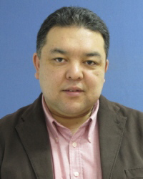
KPO Supplier Database
tba

Slide 16
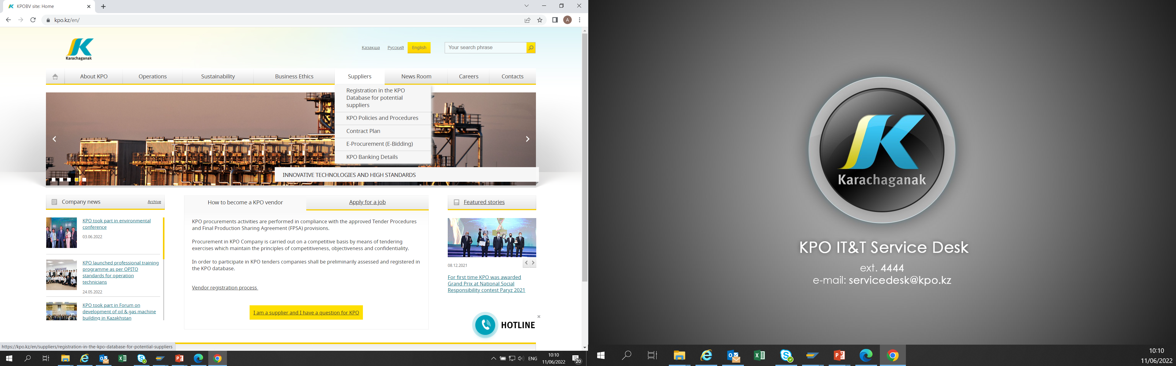
KPO SUPPLIERS DATABASE

Slide 17
VENDOR REGISTRATION
All potential suppliers shall be registered in KPO Database
REGISTRATION PROCESS
REGISTRATION
Provision of information on:
Technical Competency
Work Experience in the declared categories of goods and / or works and / or services
Personnel Availability
Financial Turnover
etc.
ETHICAL DUE DILIGENCE
Define an Ethical Due Diligence level in accordance with KPO Legal requirements:
Compliance with Kazakhstan and Foreign legislation
Compliance with Company internal regulations
Submission of potential suppliers shareholder lists
Vendor registration in KPO Vendor Database does not guarantee the participation in a tender or contract award, but suggests that a registered company may be considered as a market research participant for provision of goods, works and services for further pre-qualification process or tender as the need arises.

Slide 18
VENDOR REGISTRATION
To register in KPO Vendor Database, potential supplies shall:
  Download a questionnaire on KPO website – https://kpo.kz/ru/postavshchikam/registracija-v-baze-dannykh-postavshchikov-kpo
  Fill in the questionnaire for the preliminary vendor assessment and indicate activity codes
  Attach copies of required documents
  Submit the completed pack of documents for vendor assessment and registration by e-mail at MIVQ@kpo.kz
  Contact phone: +7 (711336) ext. 4943, 4946, 2192
  KPO encourages Suppliers to update registration data on an ongoing basis, related to:
    Work Experience in the declared categories of goods, works, services
    Certification, accreditation
    Reorganization
    Contact persons

Slide 19
MARKET RESEARCH
Purpose
  Define potential suppliers of goods, works, services who can perform as per KPO requirements
  Ensure free competition for KPO tenders
PROCESS
Demand determination and vendor searching
Issue of Invitation Letter for Expression of Interest
Market Intelligence Report
Approved
Tender List
Approvals

Slide 20
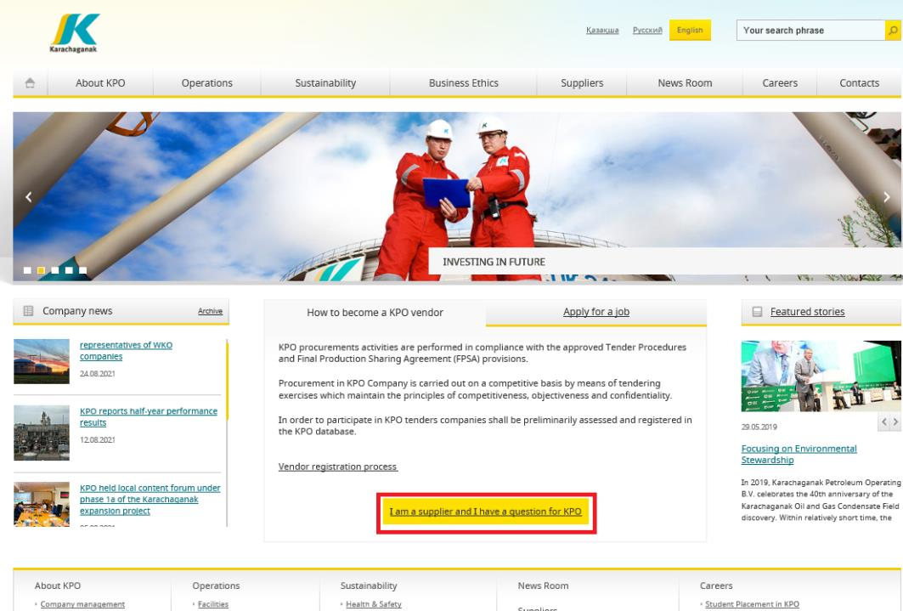
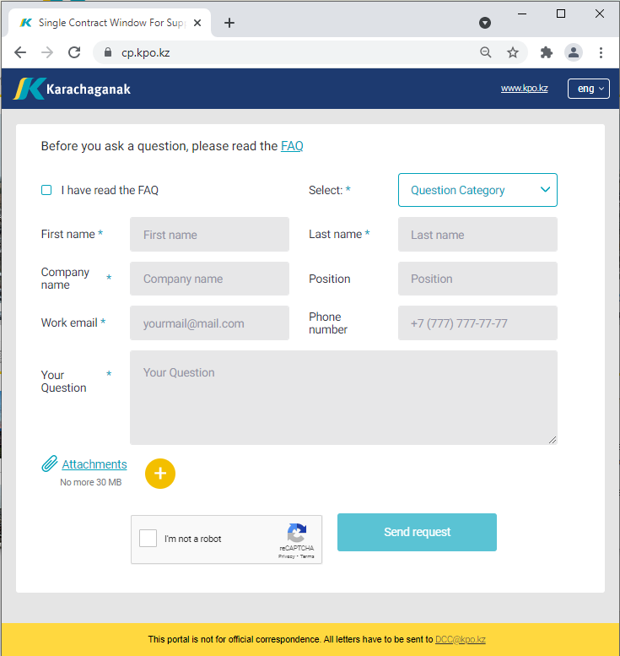
‘’SINGLE WINDOW’’ SYSTEM

Slide 21
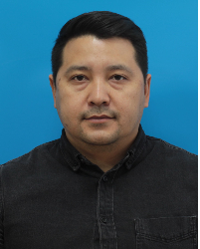
PROCUREMENT
PROCESS
Contracts and Procurement Compliance Manager
KPO

Slide 22
PROCUREMENT PROCESS
KPO shall perform the procurement activities in accordance with:
  the Final Production Sharing Agreement (confidential and intended only for the use of KPO, its Shareholders and the Republic) and the Joint Operating Committee’s Tender Procedures (JOC)
  current legislation
  approved budget and work program
PROCESS
MARKET RESEARCH / PREQUALIFICATION
INVITATION
TO TENDER
TENDERING PERIOD
TENDER DUE DATE
EVALUATION OF TENDERS
CONTRACT AWARD
CONTRACT
SIGNING
CONTRACT
PERFORMANCE

Slide 23
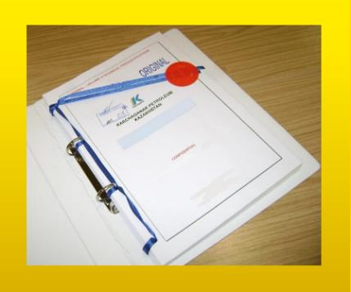



MAXIMUM ATTENTION SHALL BE PAID TO
TENDER PACKAGES SUBMISSION REQUIREMENTS
TENDER PACKAGES SUBMISSION REQUIREMENTS THROUGH E-BIDDING SYSTEM
(Link to the instructions)
INSTRUCTIONS
TO TENDERERS
TENDER DUE DATE / TIME

Slide 24
TENDER DOCUMENTATION CONTENTS
Cover letter
Forms, that shall be mandatorily signed, stamped and provided within timeframe specified:
Tender Acknowledgement and Confidentiality Agreement
Form of Tender
Certificate of Corporate Ownership and Declaration of Compliance
A package of documents related directly to the tender subject itself
Instructions to Tenderers
Form of Contract includes:
Form of Agreement
Schedule A – General Terms and Conditions
Schedule B – Scope of Goods/Services to be Supplied and Specifications
Schedule C – Compensation and Payment
Schedule D – Health, Safety and Environment (HSE) requirements
Schedule E – Special Conditions
Schedule F – Statement of Local Content
Schedule H – Industrial Relations
Questionnaire for Tender Participants
List of goods and technical delivery conditions (if applicable)
Instructions for preparing a tender proposal:
Instructions to Tender Participants
Bid marking template
08/04/2024 CONFIDENTIAL KARACHAGANAK PETROLEUM OPERATING B.V.

Slide 25
Mechanisms to support Kazakhstani Suppliers

Slide 26
KEY PRINCIPLES FOR KPO LOCAL CONTENT
In accordance with the FPSA, the Operator shall strive to maximize the use of GWS from Kazakhstani sources at each stage of the procurement process where procurement from such sources is justified in terms of price competitiveness, efficiency, operational parameters, terms of delivery and quality.
KPO, as one of the leading oil and gas companies in the Republic of Kazakhstan, strives to support the sustainable development of local suppliers in Kazakhstan and maximize opportunities for LC development, in accordance with the obligations of the FPSA and the legislation of the Republic of Kazakhstan.
The company fully supports the initiatives of the Government of the Republic of Kazakhstan aimed to the development of local suppliers, and recognizes the importance of attracting more local manufacturers to the Karachaganak project development. On this occasion, KPO is implementing various initiatives to develop local content.
Therefore, before implementing new processes, philosophies, optimization or development programs, KPO strives to:
1. Save the achieved LC level
2. Increase the share of LC
3. Continuously expand the range and list of purchased goods from local manufacturers
08/04/2024 CONFIDENTIAL KARACHAGANAK PETROLEUM OPERATING B.V.

Slide 27
MECHANISMS TO SUPPORT KAZAKHSTANI SUPPLIERS AND LOCALIZE PRODUCTION
NAME OF THE MECHANISM | DESCRIPTION
Early tender | a form of Advance Procurement* The method of awarding the contract is a competitive tender process The goal is to organize the production of goods in the Republic of Kazakhstan. A tender for the supply of goods based on the results of which the Operator enters into a contract for the supply of goods with a suspensive condition or with a long-term delivery schedule until the Operator has a need for such goods.
Trial Order | Operator contract Contract award methods - Tender, Negotiation, Single source, Sole source. The purpose of such a contract is to purchase samples of Goods from Kazakhstani manufacturers for testing and checking for compliance with technical standards and operational requirements of KPO. Basic conditions of the Trial order Conformity of the Goods to the type for oil and gas operations Minimum purchase volume Objectivity of tests and inspections
*Advance Procurement means a form of procurement as a result of which the Operator agrees a contract for goods the delivery of which may be delayed or subject to a multi-year schedule depending on Operator’s requirement for such goods, including but not limited to Early Tenders.
27
08/04/2024 CONFIDENTIAL KARACHAGANAK PETROLEUM OPERATING B.V.

Slide 28
MECHANISMS TO SUPPORT KAZAKHSTANI SUPPLIERS AND LOCALIZE PRODUCTION
NAME OF THE MECHANISM | DESCRIPTION
Contract in exchange for investment | A contract in exchange for investment is a long-term contract concluded on a Single source basis, under which the supplier undertakes to produce goods of local origin that are the subject of a procurement contract in the territory of the Republic of Kazakhstan. Methods of contract award are negotiations, Single source basis. The goal is to organize the production of goods in the Republic of Kazakhstan. Basic terms of the contract in exchange for investment Long - term contract; Single source basis; Obligation to organize the production of goods of local origin on the territory of the Republic of Kazakhstan.
Kazakh Tender | Procedure for participation of Kazakhstani suppliers The method of awarding the contract is a competitive tender process exclusively among Kazakhstan suppliers of GWS. The goal is to award contracts to Kazakhstani suppliers of GWS. Conditions for holding a tender among Kazakhstani suppliers Given that: Minimum number of Kazakhstan suppliers (ii) the presence of at least 5 pre-qualified Kazakhstan suppliers, the Contractor undertakes to conduct the tender exclusively among Kazakhstan suppliers.
28
08/04/2024 CONFIDENTIAL KARACHAGANAK PETROLEUM OPERATING B.V.

Slide 29


Slide 30


